Slide 1







LIFE
BEEP
Presented by H4 HYPERS

Slide 2



PROJECT TITLE LIFE BEEP
SUBJECT : Analog Integrated Circuit DEPT : ECE SECTION : B DATE : 14.11.2025
GUIDED BY DR.T.SENTIL KUMAR DR.V.MARISELVAM

Slide 3




TEAM H4 HYPERS
HARISHWAR S 927624BEC067
HARI PRASANTH K 927624BEC064
HARISH PRANAV S 927624BEC066
HEMANATHAN A 927624BEC072

Slide 4
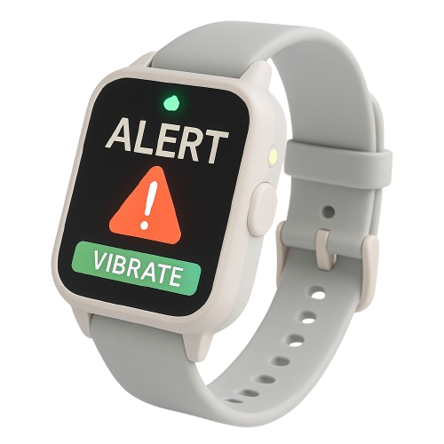
INTRODUCTION
The Smart Alert Notifier Watch is an assistive wearable designed for elderly and hearing-impaired users. It captures surrounding sounds, enhances them using Op-Amps, and employs an ESP32 to classify events such as a baby’s cry, doorbell, or vehicle horn. Detected sounds are instantly conveyed through vibration and visual alerts, ensuring safety, awareness, and independence.

Slide 5
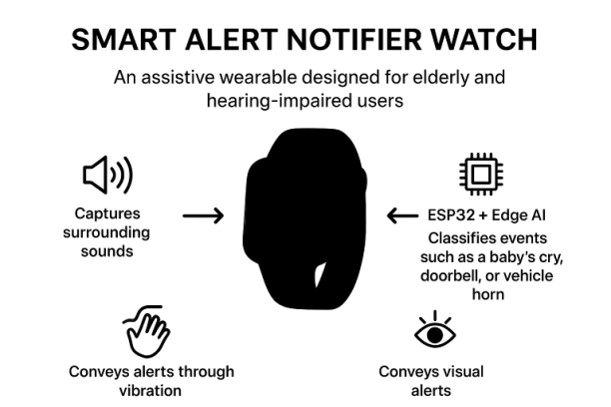
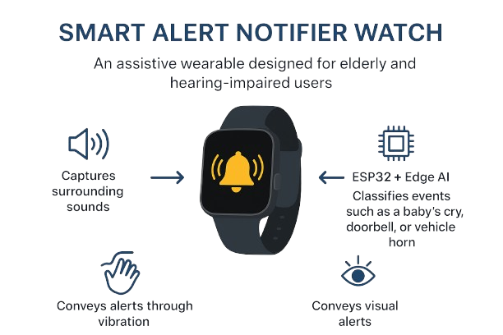


PROJECT OVERVIEW

Slide 6
PROJECT CONCEPTS
• Detects and classifies environmental sounds
• Provides multi-modal alerts: vibration + light
• Compact, wearable, and user-friendly design
• Low power consumption with rechargeable battery

Slide 7
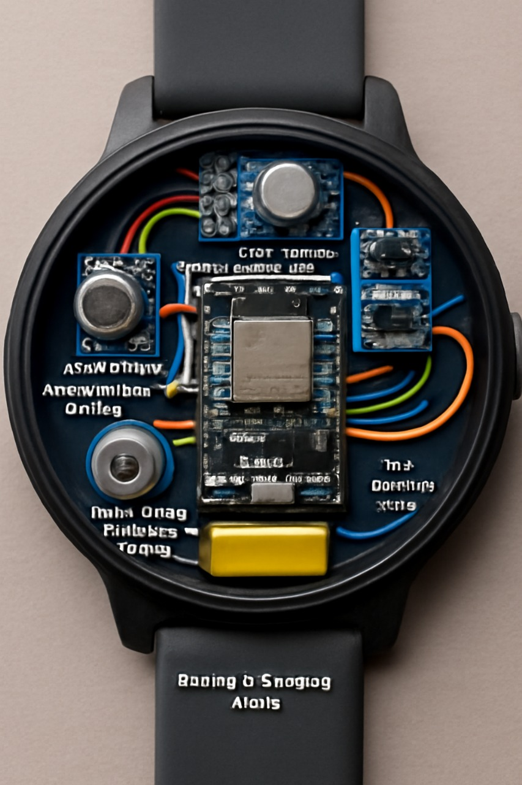
OBJECTIVE
The objective of this project is to develop a compact and portable device that converts important surrounding sounds into vibration alerts, thereby assisting people with hearing impairments in their daily activities.

Slide 8
PRINCIPLE
1. Sound Capture & Enhancement → Microphone + Op-Amp preamplifier
2. Filtering & Noise Reduction → Band-pass filter (Op-Amp)
3. Sound Analysis & Classification → ESP32
4. Alert System → Vibration motor + LED light indicators

Slide 9
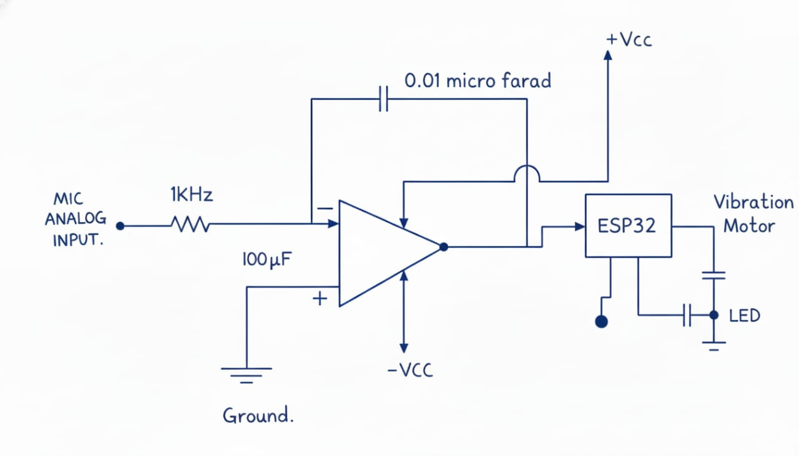
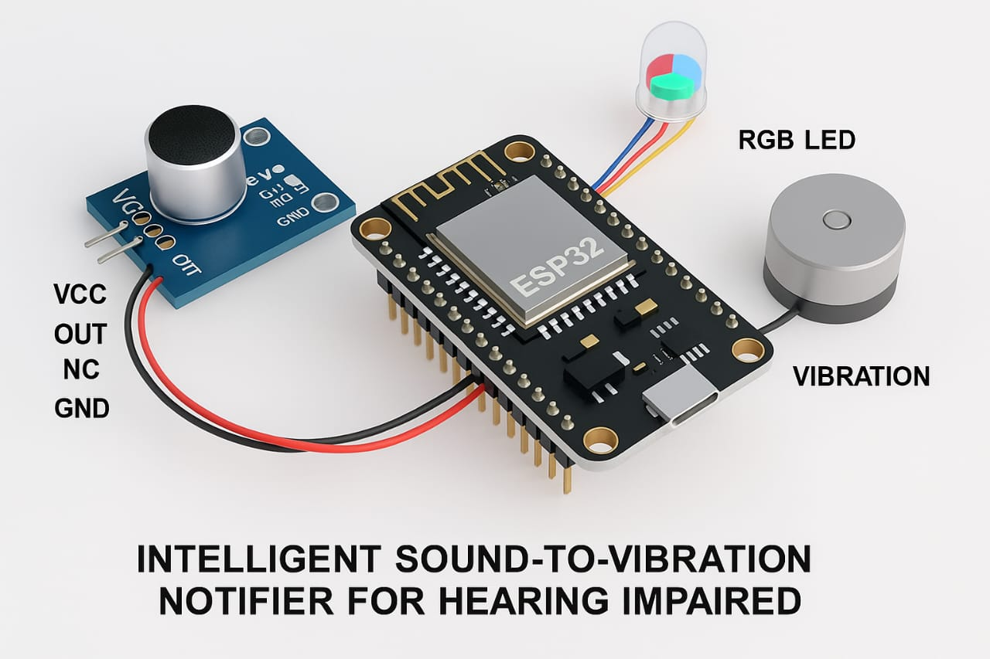
CIRCUIT DIAGRAM
IC741

Slide 10
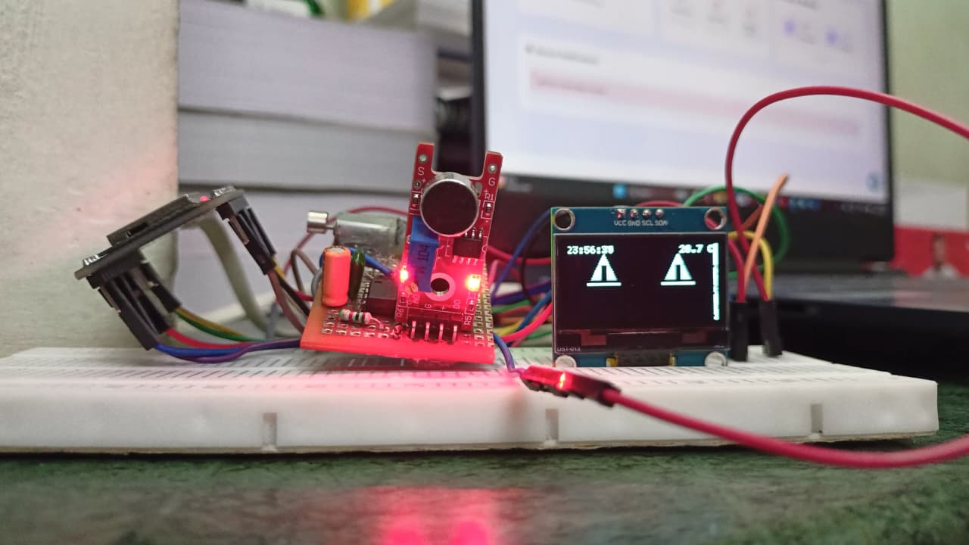
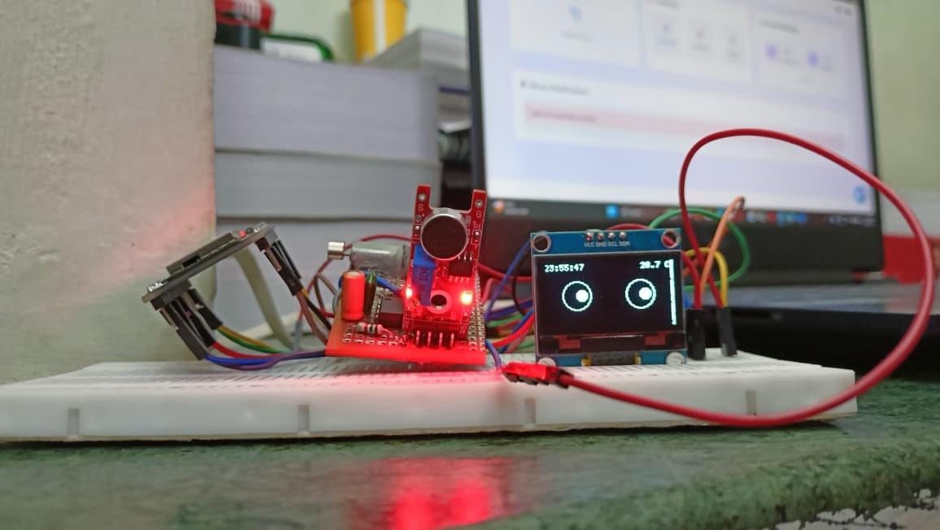
PROTOTYPE
IC741

Slide 11
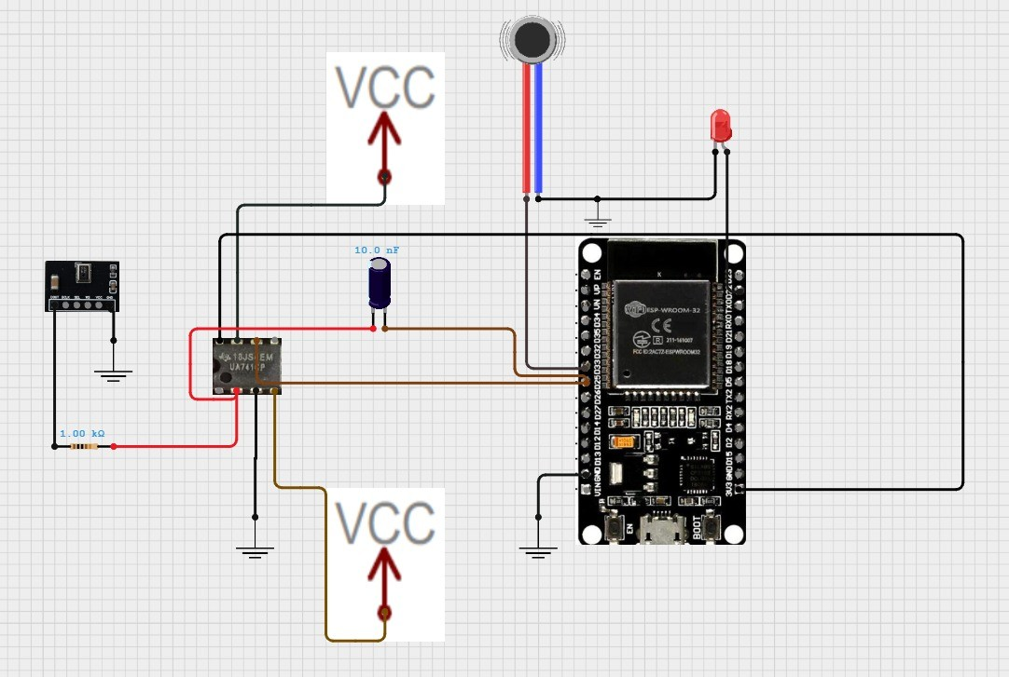
CIRCUIT CONNECTION
IC741

Slide 12
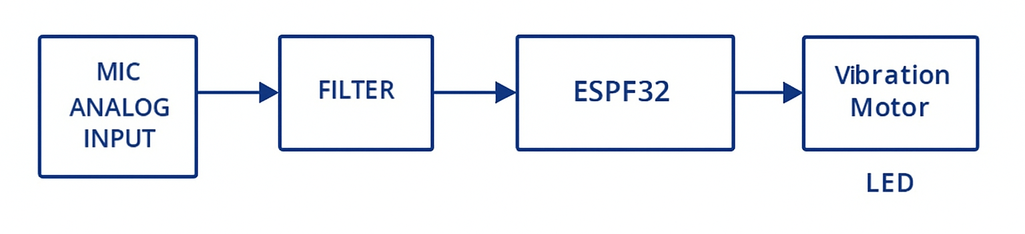
BLOCK DIAGRAM

Slide 13
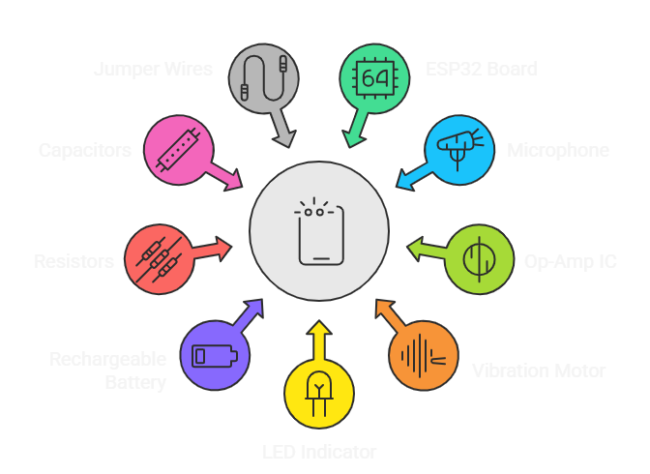
COMPONENTS USED

Slide 14
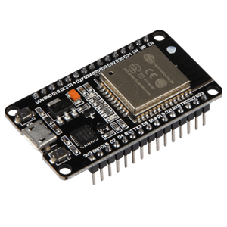
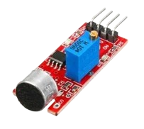
COMPONENTS DESCRIPTION
ESP32 Development Board (DevKit)
*Description: High-performance microcontroller with Wi-Fi + Bluetooth.
*Role in Project: Runs edge-AI sound classification and controls the alert system.
*Key Points:
Real-time audio detection
Supports ML models
Compact & power-efficient
Microphone Module
*Description: Sensitive sensor that converts sound waves into electrical signals.
*Role in Project: Captures environmental emergency sounds (horns, ambulance, voice).
*Key Points:
High sensitivity
Low noise
Ideal for wearable devices

Slide 15
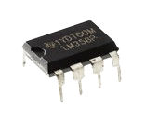
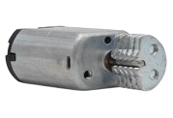
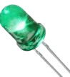
COMPONENTS USED
LM741 Op-Amp IC
*Description: Dual operational amplifier for analog signal conditioning..
*Role in Project:
*Amplifies weak mic signals
* Implements band-pass filtering for emergency frequencies
*Key Points:
*Clean signal amplification
*Enhances overall detection accuracy
Vibration Motor (3V)
Provides tactile alert when critical sound is detected.
Compact and ideal for wearable feedback.
LED Indicator
Visual alert when ESP32 detects emergency frequencies.
Low-power and easy to drive.

Slide 16
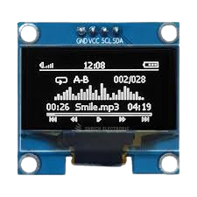
COMPONENTS USED
OLED Display (0.96” I2C – SSD1306)
Description: A low-power, high-contrast miniature display used for showing visual information clearly.
Role in Project: Displays real-time clock, alert symbols, and warnings when emergency sounds (ambulance, horn, voice) are detected.
Key Points:
High brightness and sharp visibility
Low power consumption — ideal for wearables
Shows clear warning icons and status information
Simple I2C interface for easy ESP32 integration

Slide 17
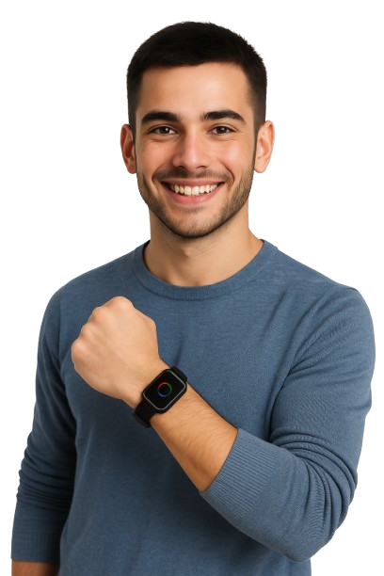
CONCLUSION
The Smart Alert Notifier Watch provides a reliable assistive solution for elderly and hearing-impaired users. By detecting important sounds and converting them into vibration and light alerts, it improves safety, awareness, and independence in daily life. This project demonstrates how simple hardware and AI integration can create impactful wearable technology.

Slide 18
THANK YOU
Presented by H4 HYPERS

